Slide 1
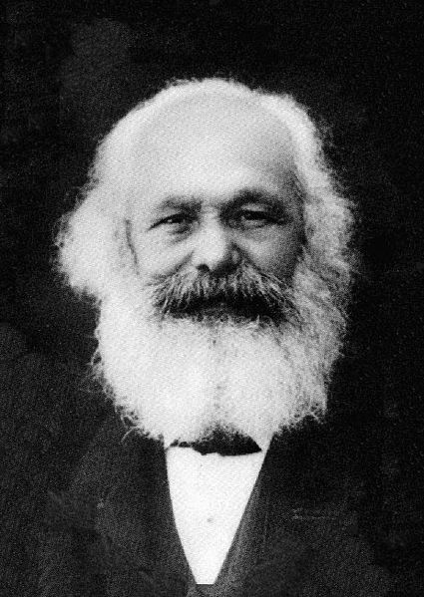
What do these three men share?
Georg Wilhelm Friedrich
Hegel
Sergei Eisenstein
Karl
Marx

Slide 2
Battleship Potemkin 1925
Dialectic Montage
Soviet Montage
Odessa Steps scene

Slide 3
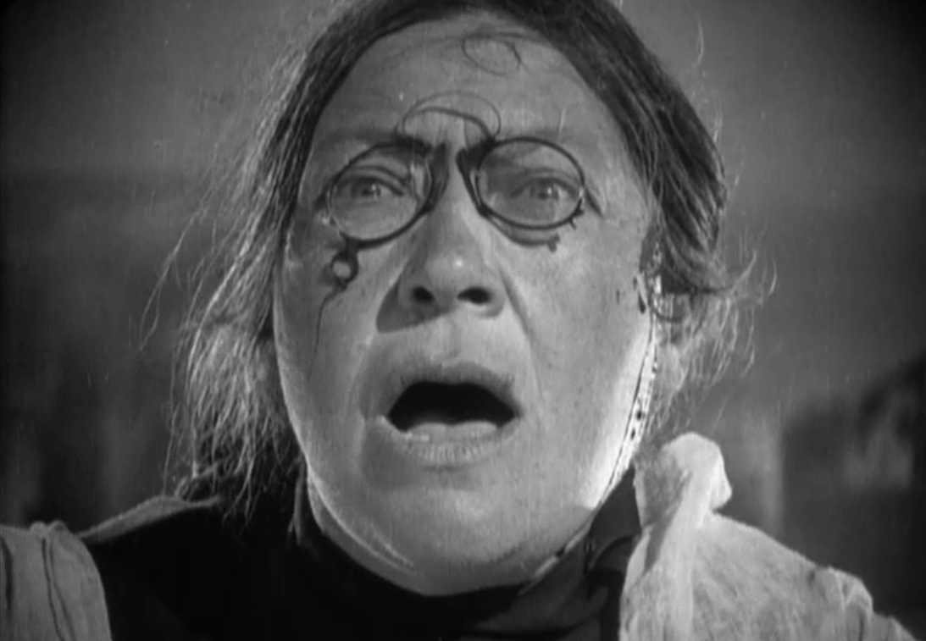
Montage
Juxtaposes images by editing
Uses various camera angles with cut away shots- like a storyboard
Eisenstein’s theory has influenced contemporary film and video
Eisenstein believed that film montage could create ideas or have an impact beyond the individual images.
Two or more images edited together create a third thing that makes the whole greater than the sum of its individual parts.

Slide 4
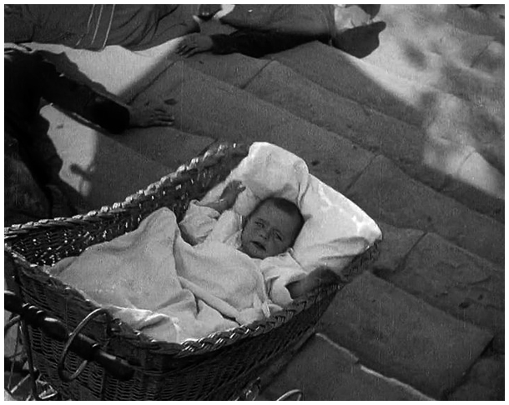
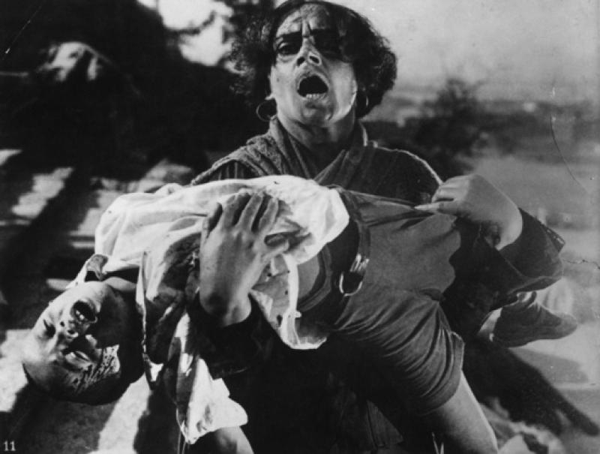
Eisenstein's greatest demonstration of the power of montage comes in the "Odessa Steps" sequence of his 1925 film Battleship Potemkin.
On the simplest level, montage allows Eisenstein to manipulate the audience's perception of time by stretching out the crowd's flight down the steps for seven minutes, several times longer than it would take in real time.
There is a much deeper level to the collision of two shots/ images.

Slide 5
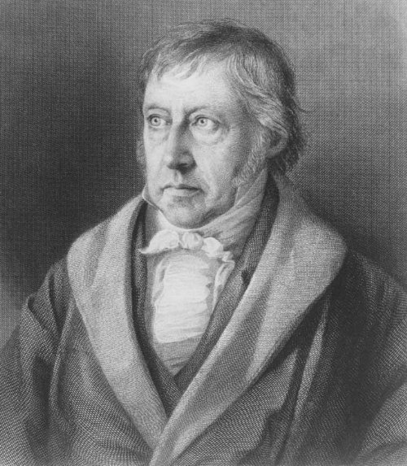
Hegel was a philosopher
His studies included the life-process of the human brain and the process of thinking that leads to an idea.

Slide 6
Marx was a philosopher who was influenced by Hegel.
Some of his theories explore the translation of the material world into independent forms of thought.

Slide 7
di·a·lec·tic
1. The art or practice of arriving at the truth by the exchange of logical arguments.
2. The process associated with Hegel of arriving at the truth by stating a thesis, developing a contradictory antithesis, and combining and resolving them into a coherent synthesis. Linked to conflict theory.
3. A method of argument or exposition that systematically weighs contradictory facts or ideas with a view to the resolution of their real or apparent contradictions.
4. The Marxian process of change through the conflict of opposing forces, whereby a given contradiction is characterized by a primary and a secondary aspect, the secondary succumbing to the primary, which is then transformed into an aspect of a new contradiction.

Slide 8
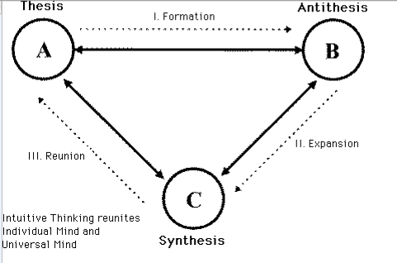
The nature of the montage is to generate an intellectual idea from the collision of independent shots

Slide 9
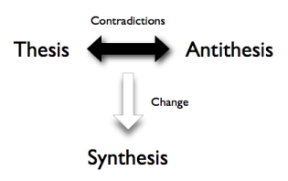
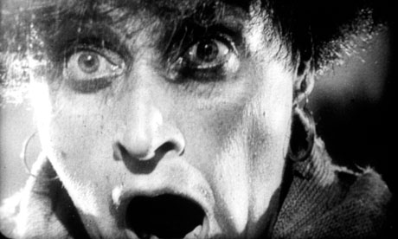
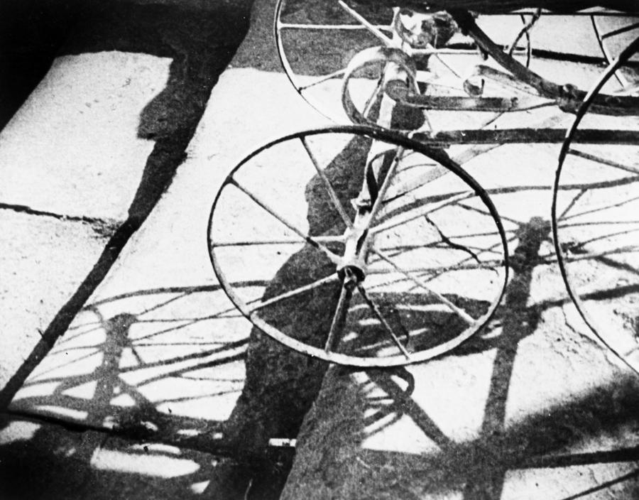
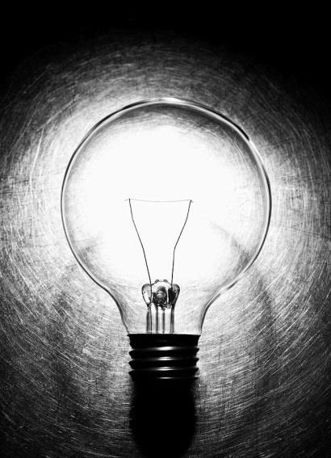
Independent Translations and Ideas

