Slide 1
Makeupbycdo
By: Christina Do

Slide 2
Makeupbycdo
An undiscovered, yet hopeful makeup artist trying to make it in the real world conquering one social media platform at a time - starting with Instagram.
THE STORY
A girl with a crazy and passionate obsession with makeup ever since she was a kid, having a dream she thought she could never make herself start the path towards.
THE BRAND
Self owned and started by an 18 year old girl who took a big leap of faith on a late summer night.
Makeupbycdo is an aspiring makeup artist. She freelances for photographers, family and friends.
Makeup Artist. Aspiring. Freelance. Client Satisfaction.

Slide 3
1.
The Inspiration
Let’s start with what inspired me.

Slide 4
Life’s too short not to follow your heart.

Slide 5
What Personally
Inspired Me
My Uncle (Oct. 5th, 1964 - July 4th, 2016) and Cousin (who was too young to go)
To hopefully gain a better life for my family
The adventure

Slide 6
2.
The Connection
My connection to makeup.

Slide 7
The terror and beauty of the dream come from the connection of previously unrelated mundanities of life.

Slide 8
My Connection
Since I am an artist, makeup is just another form of art to me
Through makeup, you can wear your masterpiece while expressing yourself at the same time
Visual Arts was my favourite ever since 2005 and still is

Slide 9
3.
Marketing
Branding strategies I have planned.

Slide 10
My Marketing Plan
TARGET AUDIENCE
Both women and men of any age, skin type and ethnicity. Anyone who wants to get their makeup done for a special day.
SUCCESS PLAN
Practice on anyone I can, reach out to small photographers, brands and companies, try different looks, keep up with the trends and post as much as I can.
ADVERTISING
Currently just on Instagram. Friends and family sharing my work, clients/photographers tagging me in photos, reaching out to other aspiring makeup artists.

Slide 11
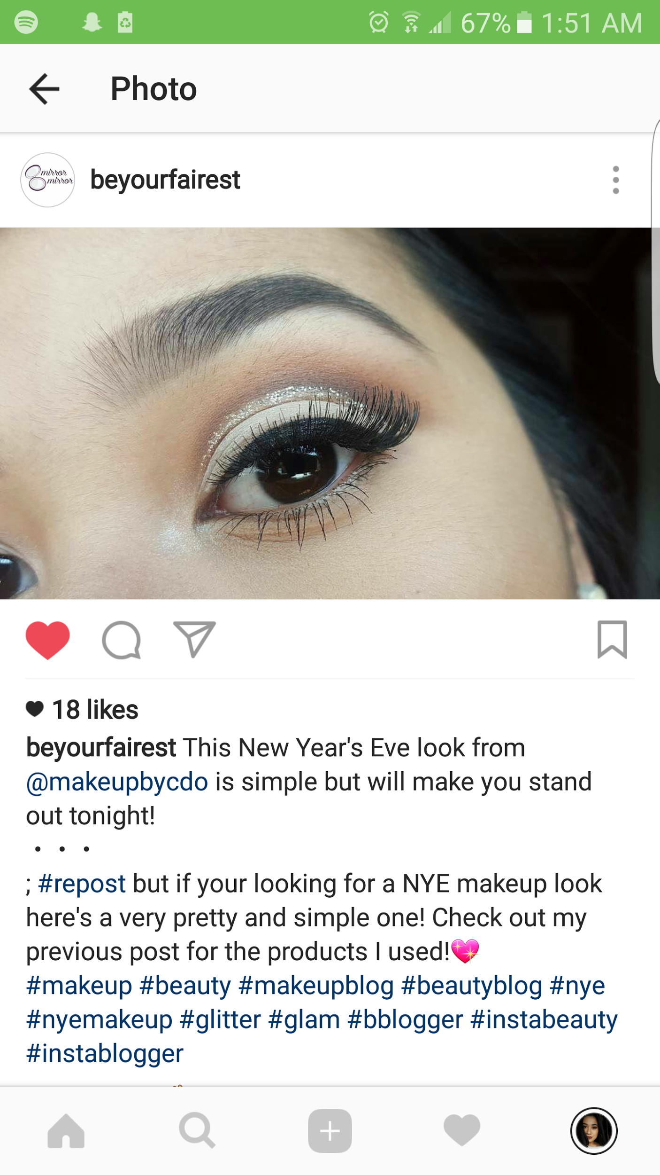
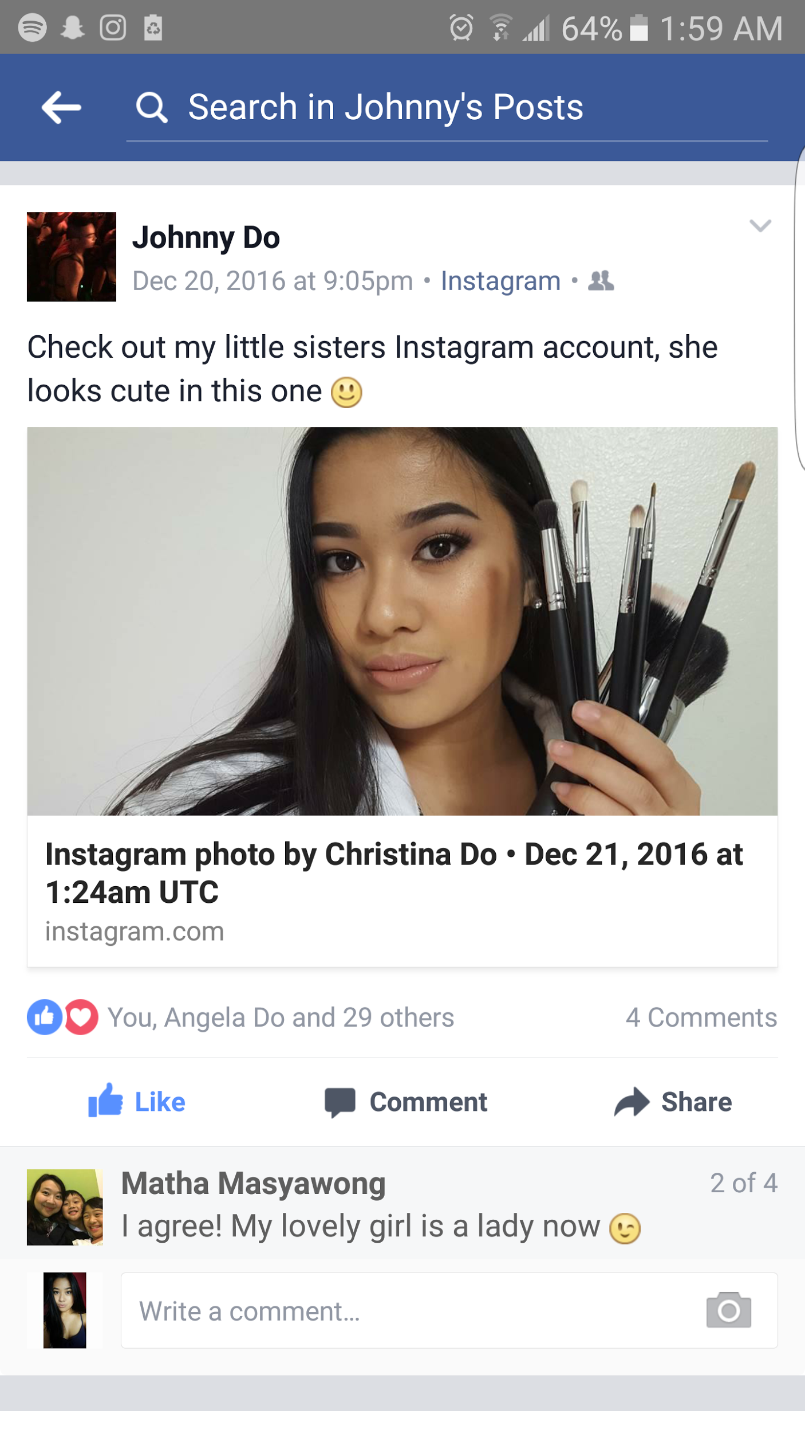
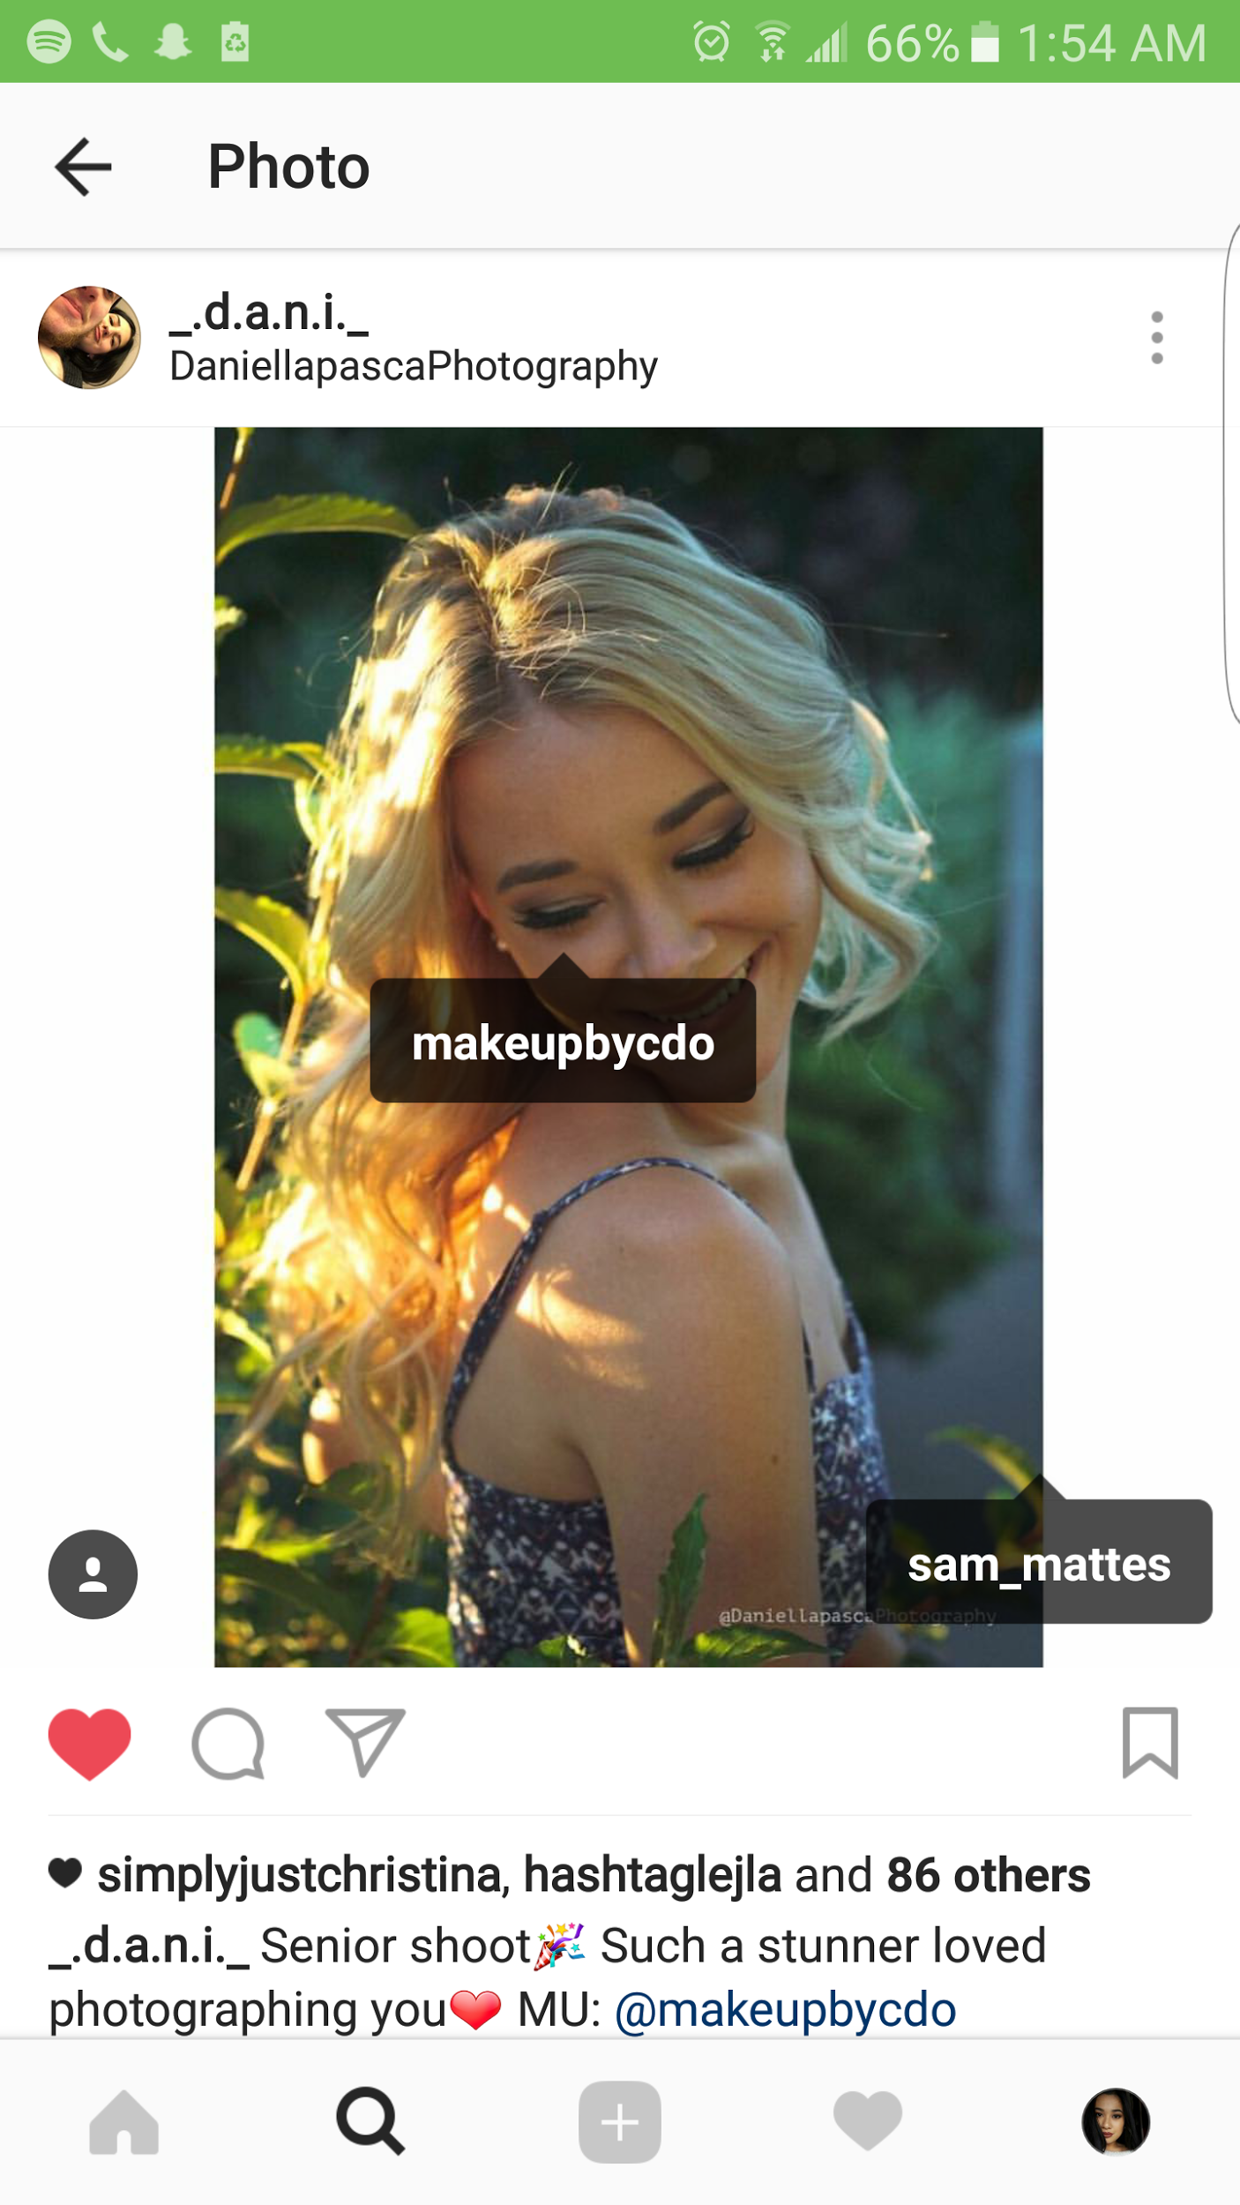

Slide 12
What I Have Ready
Instagram Account & Pictures
https://www.instagram.com/makeupbycdo/
(By the time you follow this link, everything will be up to date, not with what I began with)

Slide 13
4.
Goals
What I want to accomplish.

Slide 14
My Goals
How will I Accomplish this?
Simply to get known and gain determination skills
Go from 54 followers to at least 200 by Dec. 31st 2016
Will do my best to constantly post photos, use as many hashtags as possible and approach other aspiring makeup artists

Slide 15
How did I do?
Let’s see.

Slide 16
5.
Stats
My stats up to January 8th, 2017.

Slide 17
October 2016 vs. January 2017 Follower Data
Month | 1st Week | 2nd Week | 4th Week
October | 54 | ~ 60 | ~ 100
December | ~ 133 | ~ 167 | ~ 200
January | ~ 256 | TBD | TBD

Slide 18
4,105 likes
59 likes/post
206 comments
3 comments/post
As of January 8th, 2017

Slide 19
256 followers
~ 26 followers/week
(measured from 10 weeks)

Slide 20
Was it a Success?
Well, let me tell you...

Slide 21
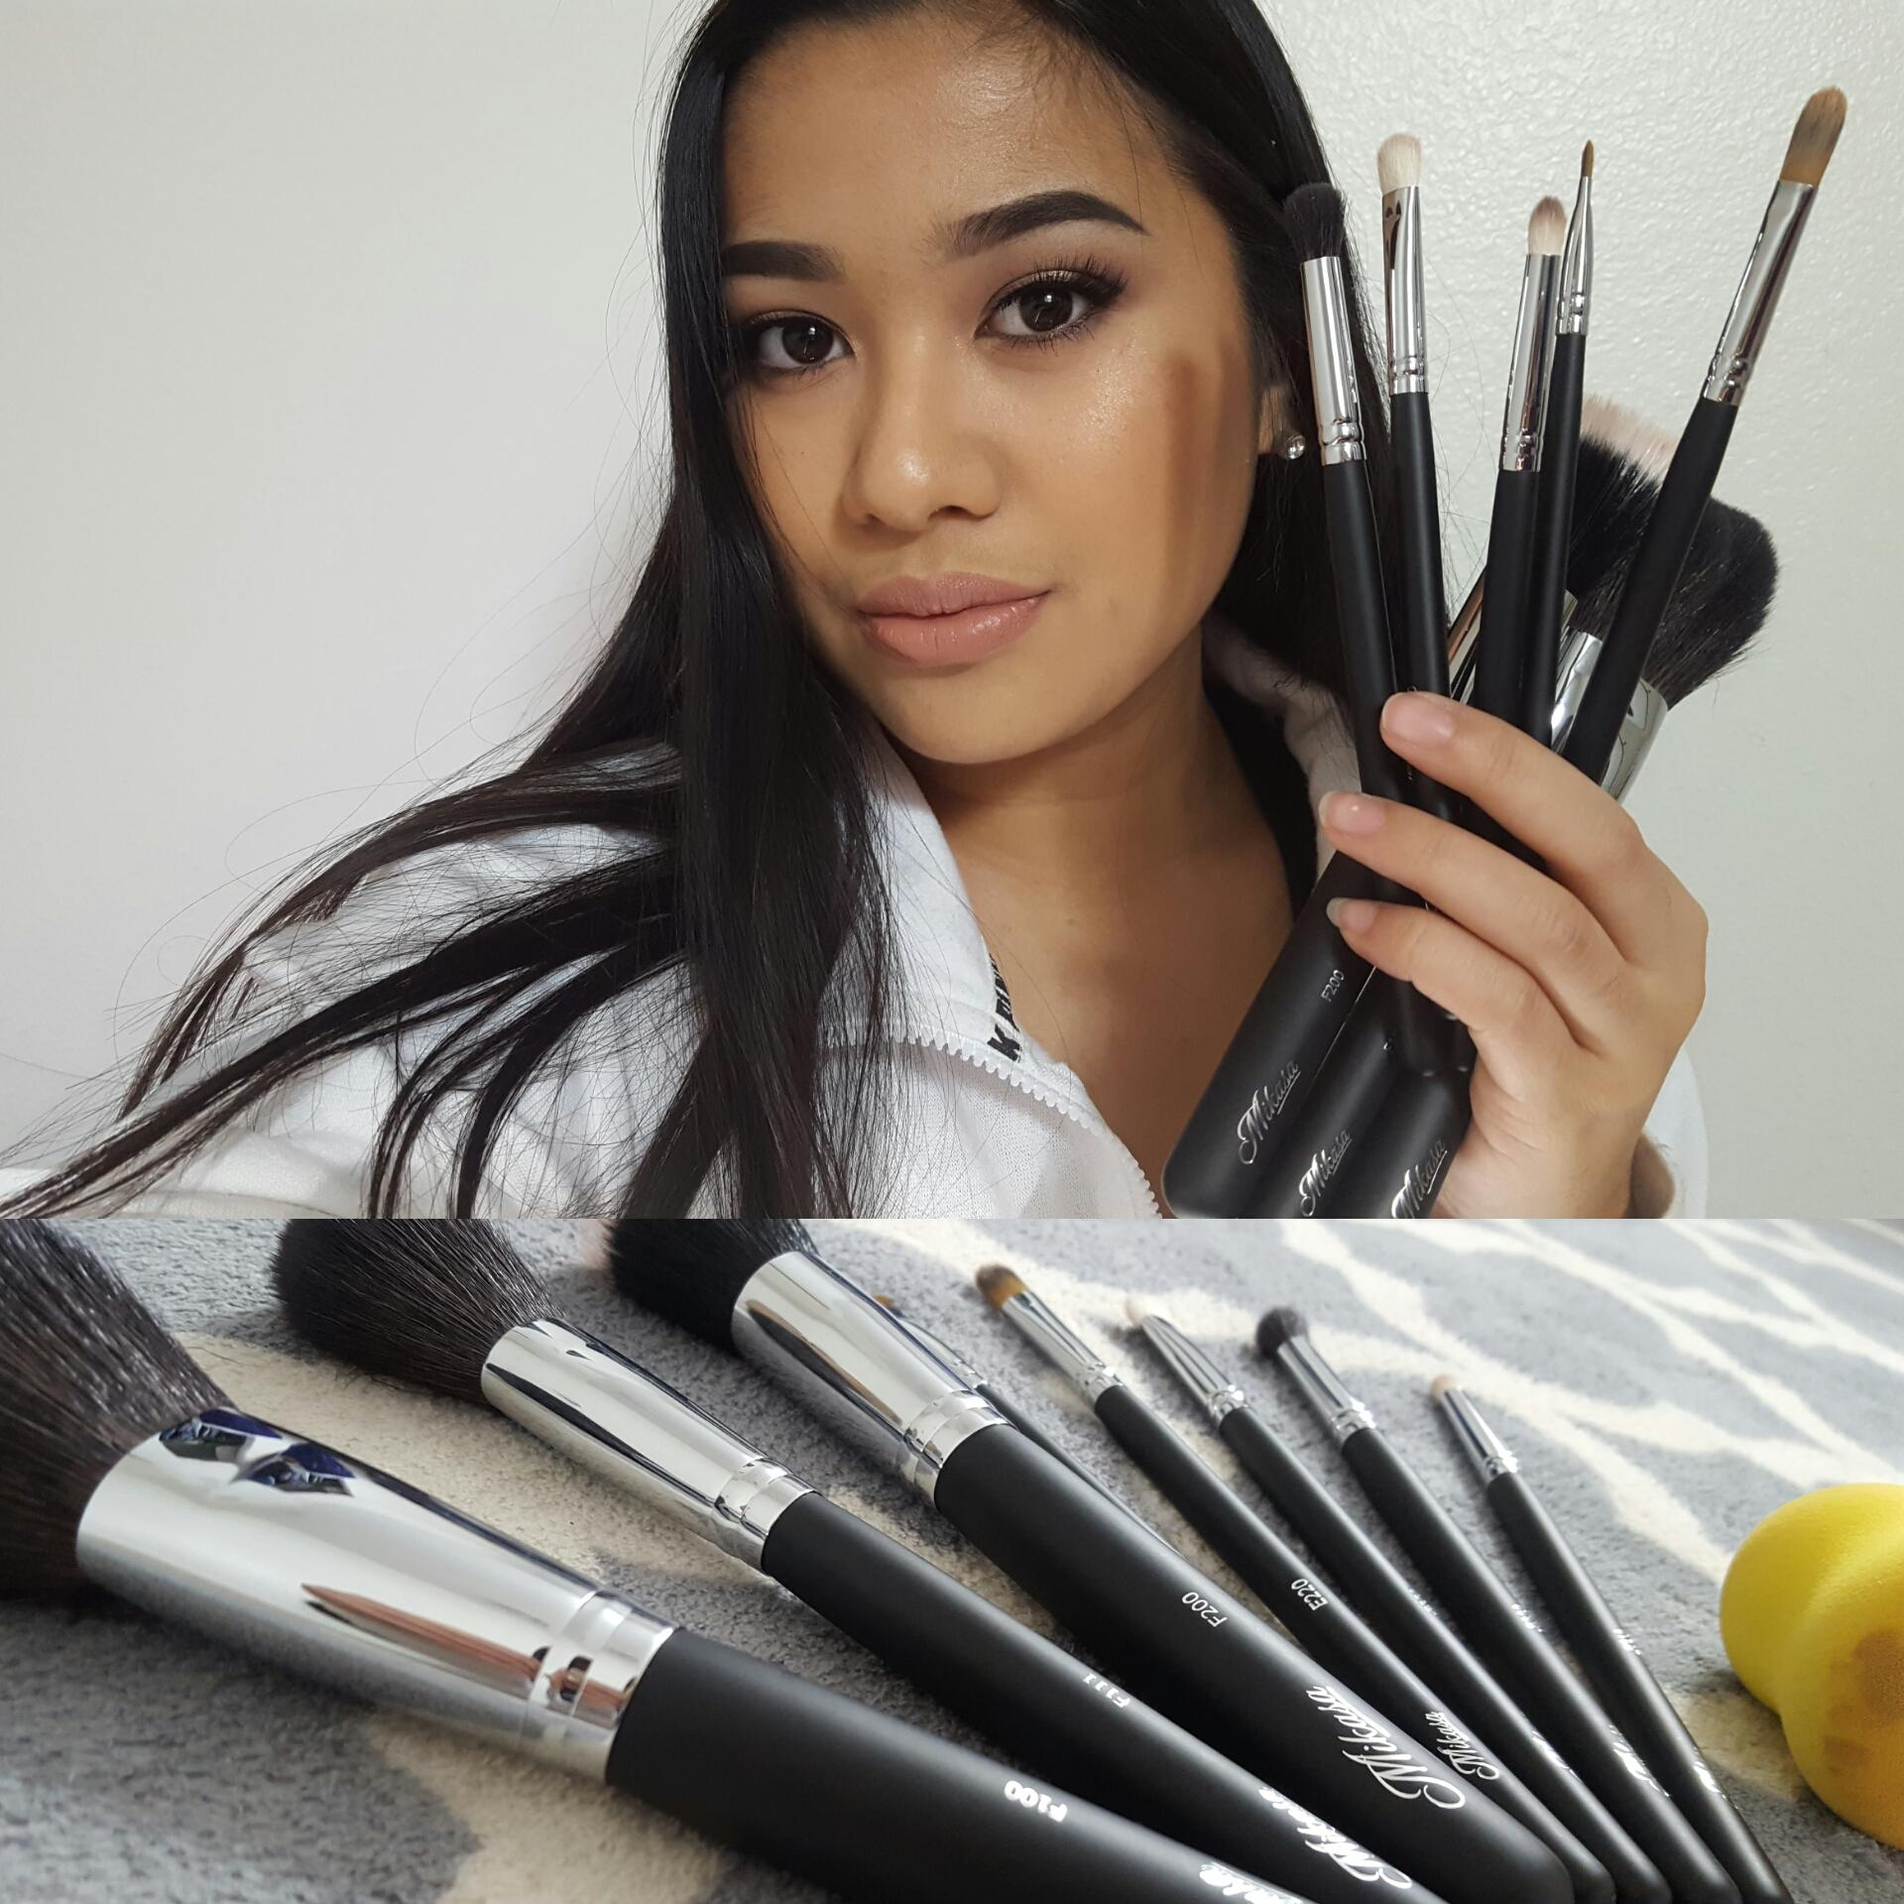
I have been contacted by Mikasa Beauty, a Canadian Makeup Brush brand, and am now affiliated with them
I've surpassed my goal of 200 followers
I have more clients than before
Have been noticed by famous Youtubers

Slide 22
Why did it Succeed?
Kept with the trends
Continuously posted
Advertised my account constantly
Did what the people wanted
Had a variety of content

Slide 23
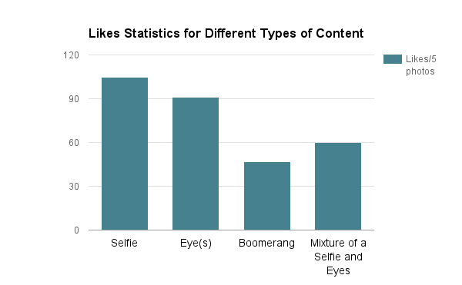
What’s popular?

Slide 24
6.
Goals vs. Outcome
Did I obtain my goals?

Slide 25
Goals
Outcome
Go from 54 followers to 200 by December 31st, 2016
Get known and gain determination skills
Now have 256 followers as of January 8th, 2017
Companies have noticed me
Determination is now at 75% instead of 30%

Slide 26
7.
The Future
What are my plans for the future?

Slide 27
What do I have planned?
Continue on this journey
Try to become 95% devoted to my brand and get my determination to 90%
Post more photos more frequently
Obtain more clients
Make a Facebook page
Work with more companies
Make Instagram tutorial videos

Slide 28
Please support me by following my Instagram:
@makeupbycdo

Slide 29
Thanks for your time!
Any questions?
You can find me at @makeupbycdo on Instagram or at christinado429@gmail.com!

