Slide 1
File Management
Do not store files in Downloads
Move the files to a proper Project Folder

Slide 2
File Management
Folders are your friends.
Know where your files are located at all times.
Start by naming a main folder such as “Tutorials” in your Documents folder.
Then organize subfolders such as “Greenscreen”.

Slide 3
Sequence Settings
Double check your Sequence Settings
Sequence
Sequence Settings
Make sure your Sequence Settings are no larger than 1920 x 1080

Slide 4
Make a New Sequence
Open the Project window
Click on the New Item icon
Select Sequence which is your editing Timeline

Slide 5
Make a New Sequence
Open Digital SLR
Select 1080p30
Make sure your Sequence Settings are no larger than 1920 x 1080

Slide 6
Check Image Size in Photoshop
Before Importing into Premiere
This image size is too large for Premiere or After Effects
Create a file that is around:
Width: 1920
Height: 1080
Resolution: 72ppi

Slide 7
Check Image Size in Photoshop
Before Importing into Premiere
This image size is a good size for Premiere or After Effects
There will be less lag and memory strain.
The file is:
Width: 1920
Height: 1270 (close to 1080)
Resolution: 72ppi

Slide 8
Premiere: Import & File Management
Right Click in Project Window
Import Files

Slide 9
Premiere: Import & File Management
Make Bins to organize imported files

Slide 10
Premiere: Add Audio & Exponential Fade
Open the Effects Window
Audio Transitions
Exponential Fade
Drag onto the Audio line

Slide 11
Exporting Videos Step 1
Mark In & Mark Out Points
This Defines the Work Area to Export

Slide 12
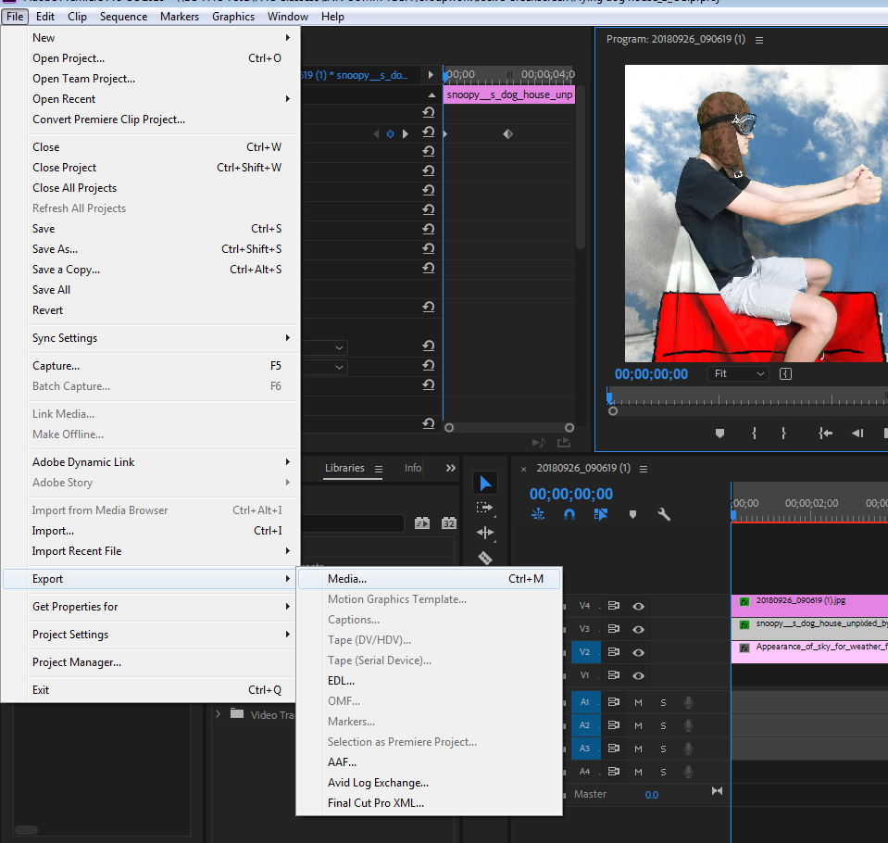
Exporting Videos Step 2
File
Export
Media

Slide 13
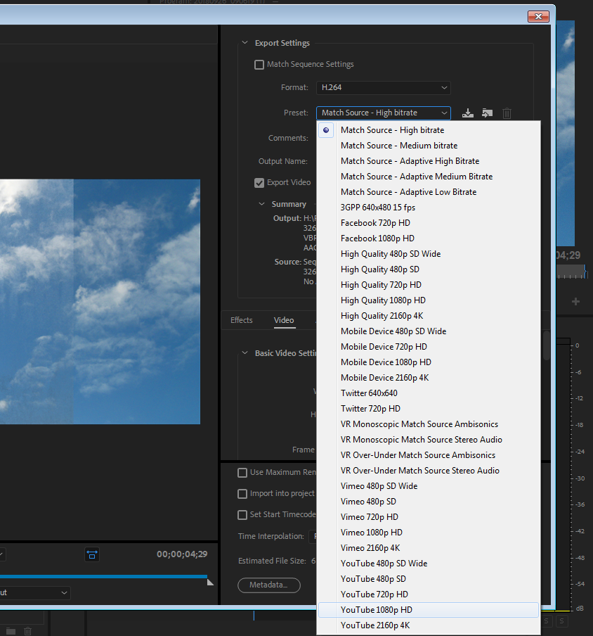
Exporting Videos Step 3
Format
H.264
Preset
YouTube 1080p HD

